Slide 1

Prediction of Top-N Popular Videos via a Cross-Domain Hybrid Model
Batch No: A-10 Project Guide:
Amrutha (164G1A0503) Mr.K.Varun Kumar Reddy M.Tech
Koushika (164G1A0540) Assistant Professor`
Manisha (164G1A0553)
Kavya (164G1A0536)
Srinivasa Ramanujan Institute of Technology
Department of Computer Science & Engineering

Slide 2
Introduction
Prediction of the top-N popular videos is of great importance to support the development of online video services(OVSs).
From the perspective of commercialization, identifying the top-N popular videos helps the video service providers to maximize their profits as advertisers are more likely to pay more for popular videos.
Prediction of the top-N popular videos remains a challenging problem for the following reasons.First,popular and unpopular videos may have similar early view patterns.Second,exisiting studies show that the strong correlation between early views and long-term popularity

Slide 3
Existing System:
The existing models has a much lower performance in predicting the top-N popular videos than that of the entire video set. Although many attempts have been made on video popularity prediction.
Some models may use caching and recommendations to make the videos popular
This overdependence on early view patterns prevents models from finding popular videos based on multisource data.

Slide 4
Proposed System:
We propose a model for predicting the top-N popular videos. By enhancing the ability of early patterns to distinguish among popularity trends and to develop a model that achieves the promised performance.
To address these challenges, we propose a novel multifactor differential influence (MFDI) prediction model based on multivariate linear regression (MLR).
The model is designed to improve the discovery of popular videos and their popularity trends are learnt by enhancing the discriminative power of early patterns for different popularity trends and by optimizing the utilization of multi-source data.

Slide 5
Cont.
We evaluate the proposed model using real-world YouTube data, and extensive experiments have demonstrated the effectiveness of our model.
By using the tags of videos as indicators of their content and jointly training a multi-layer perceptron (MLP) network on the popularity data of videos and their related social content

Slide 6
Abstract
Predicting the top-N popular videos and their future views for a large batch of newly uploaded videos is of great commercial value to online video services (OVSs).
The reason for this phenomenon is that most videos in an OVS system are unpopular, so models preferentially learn the popularity trends of unpopular videos to improve their performance on the entire video set.
However, in most cases, it is critical to predict the performance on the top-N popular videos which is the focus of this study.

Slide 7
Problem Statement
Prediction of the top-N popular videos remains a challenging problem for the following reasons. First, popular and unpopular videos may have similar early view patterns, and this similarity limits the performance benefit of video classification based early view patterns. Second existing studies show that the strong correlation between early views and long-term popularity dominates the training of the prediction models.

Slide 8
Module Description:
UPLOAD VIDEOS:
Predicting the top-N popular videos and their future views for a large batch of newly uploaded videos is of great commercial value to online video services (OVSs). Although many attempts have been made on video popularity prediction,the ability to identify the top-N popular videos is beneficial to video services, such as caching and recommendation

Slide 9
EARLY VIEW VIDEOS:
Similar early view patterns could lead to different popularity dynamics. For potential viewers, the feedback early viewers leave on videos is one of the most important of their viewing decisions and may lead to different viewing dynamics.Viewers’ attitudes can be reflected through related text, such as comments, and related behavior such as clicking “like” or “dislike” after watching.

Slide 10
PREDICT N-TOP POPULAR VIDEOS:
This problem is caused by the Pareto distribution of videos’ popularity, as most of the views received by a video set are associated with only a few popular videos. Therefore, to reduce the prediction error over the entire video set, models will preferentially learn the popularity trends of the unpopular videos, hence sacrificing prediction performance on popular videos.

Slide 11
ANALYSIS:
The analysis of the system is done in this module. The proposed algorithm’s efficiency is calculated here. The comparison of various factors can be handy to calculate and visualize in the graphs such as pie chart, bar chart, line chart. The data to plot the graph is taken from the system which is done.

Slide 12
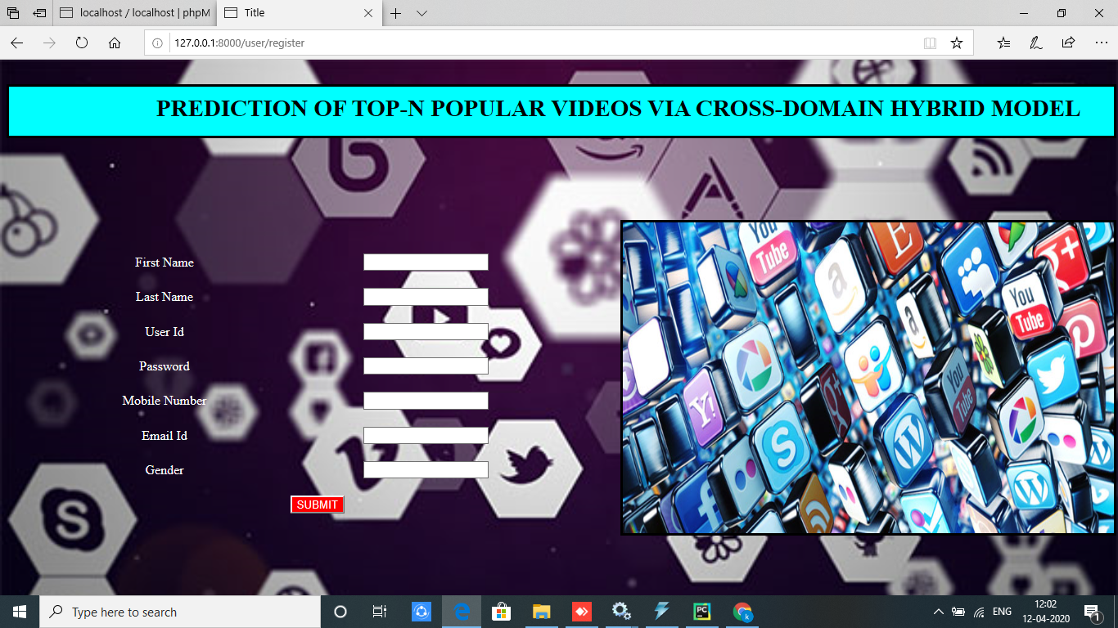
Output

Slide 13
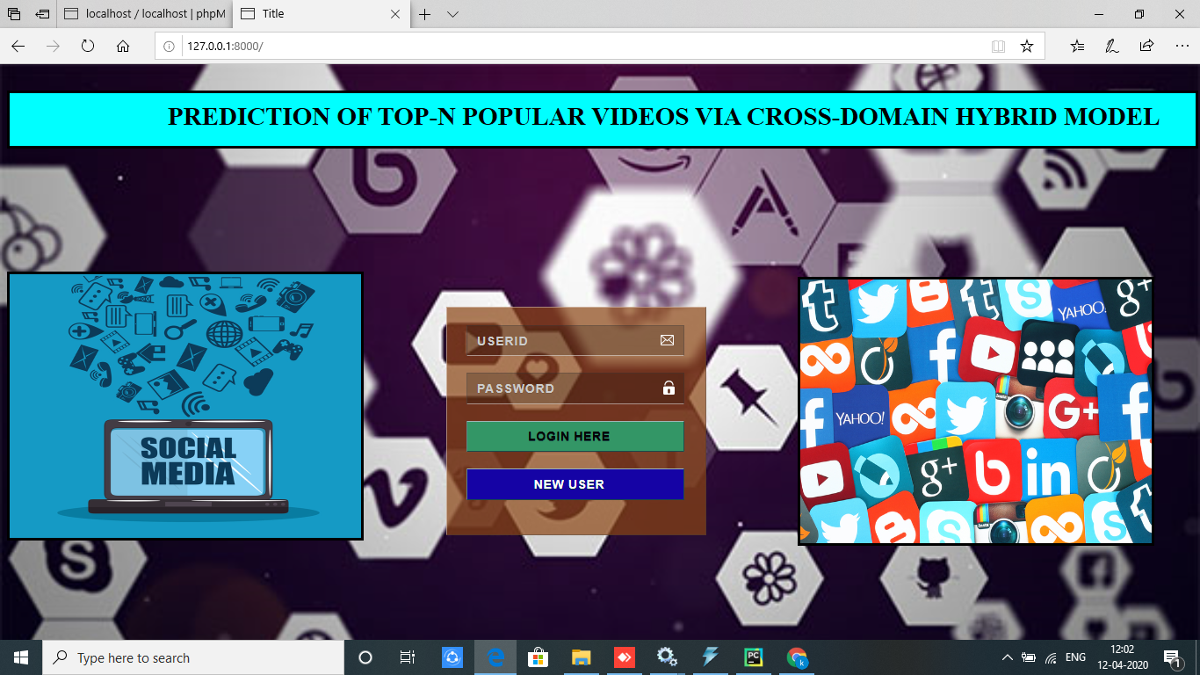
Cont.

Slide 14
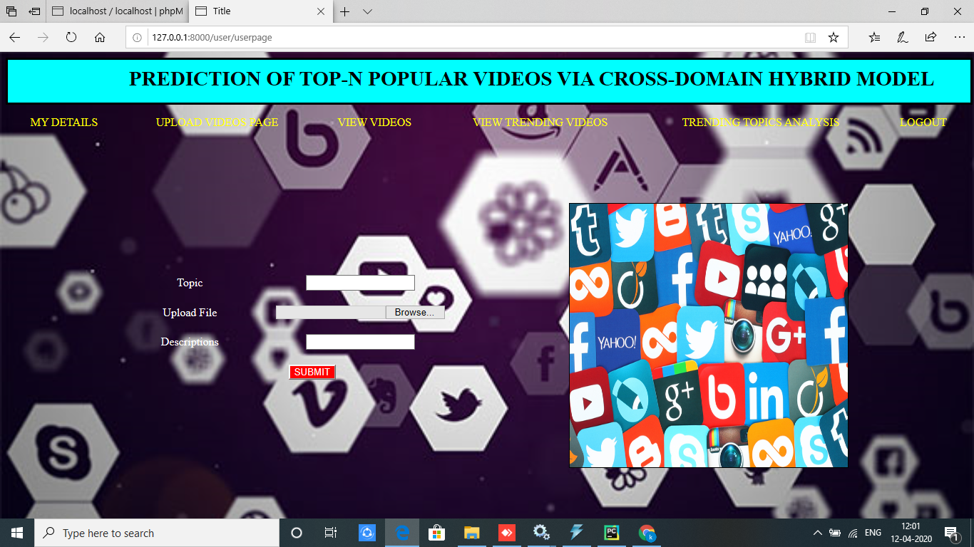
Cont.

Slide 15
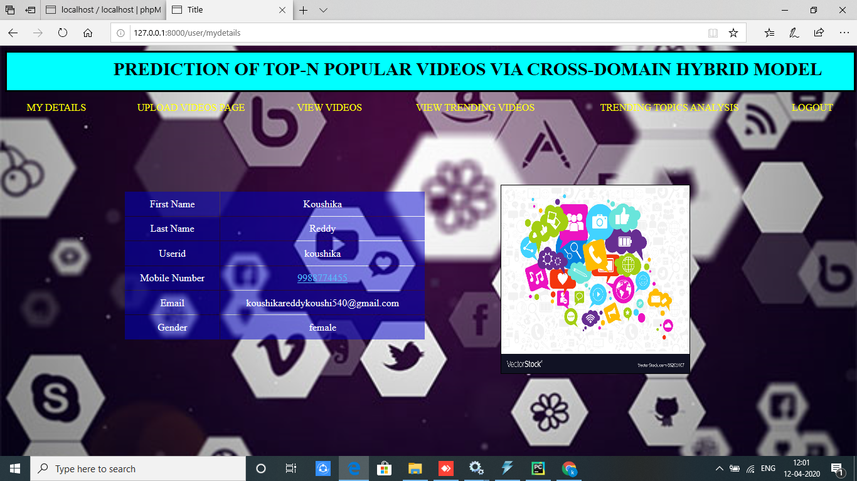
Cont.

Slide 16
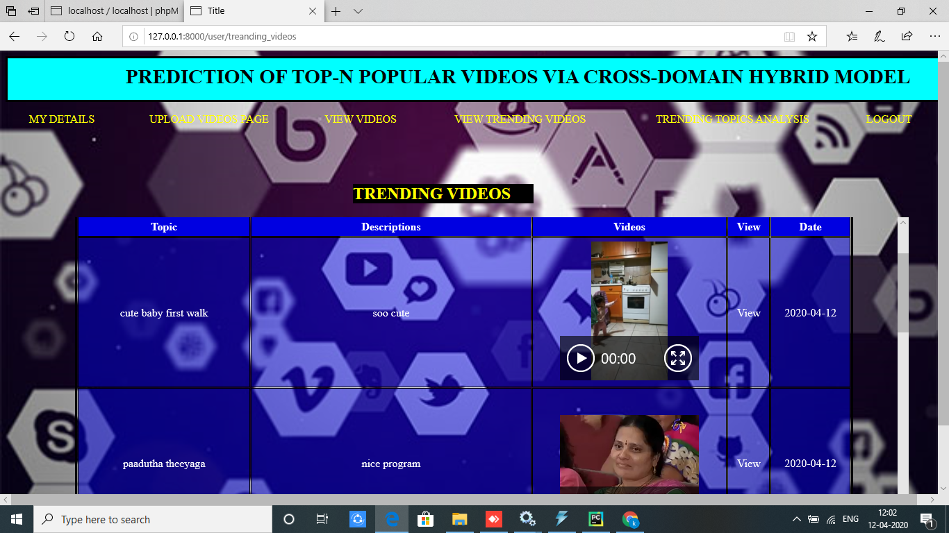
Cont.

Slide 17
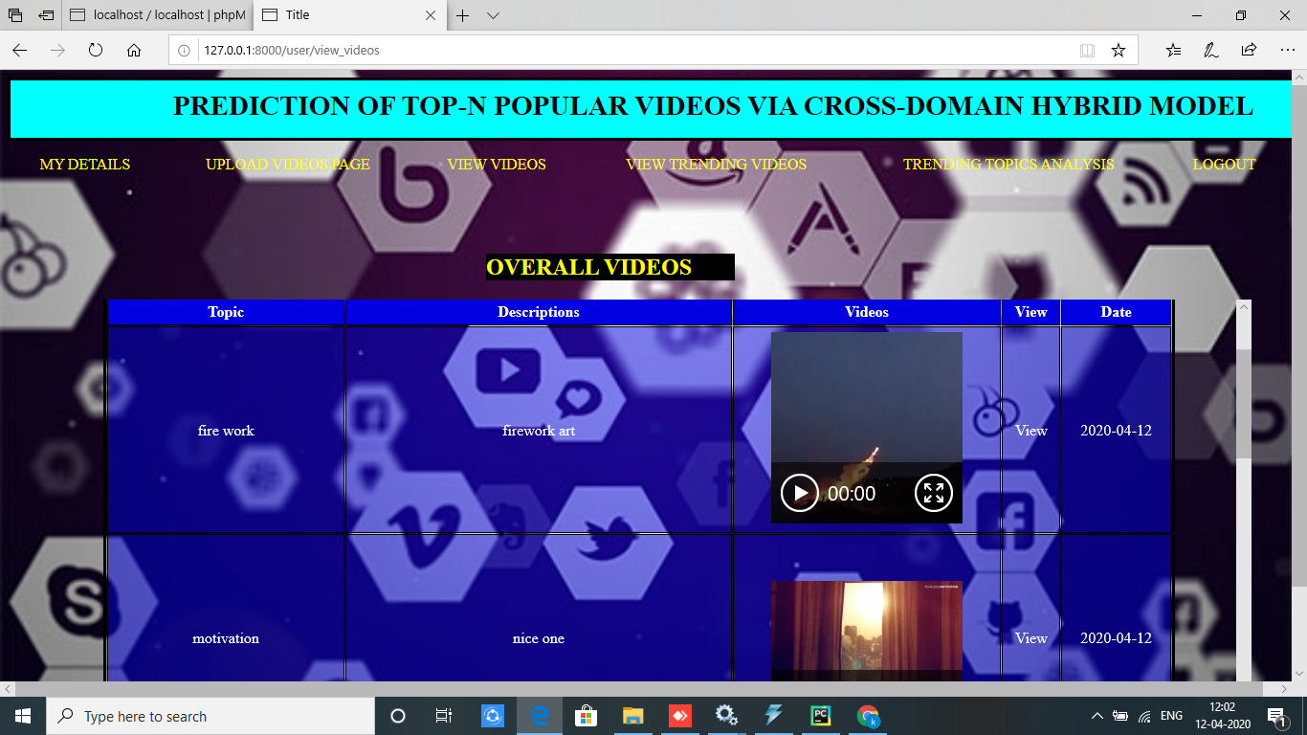
Cont.

Slide 18
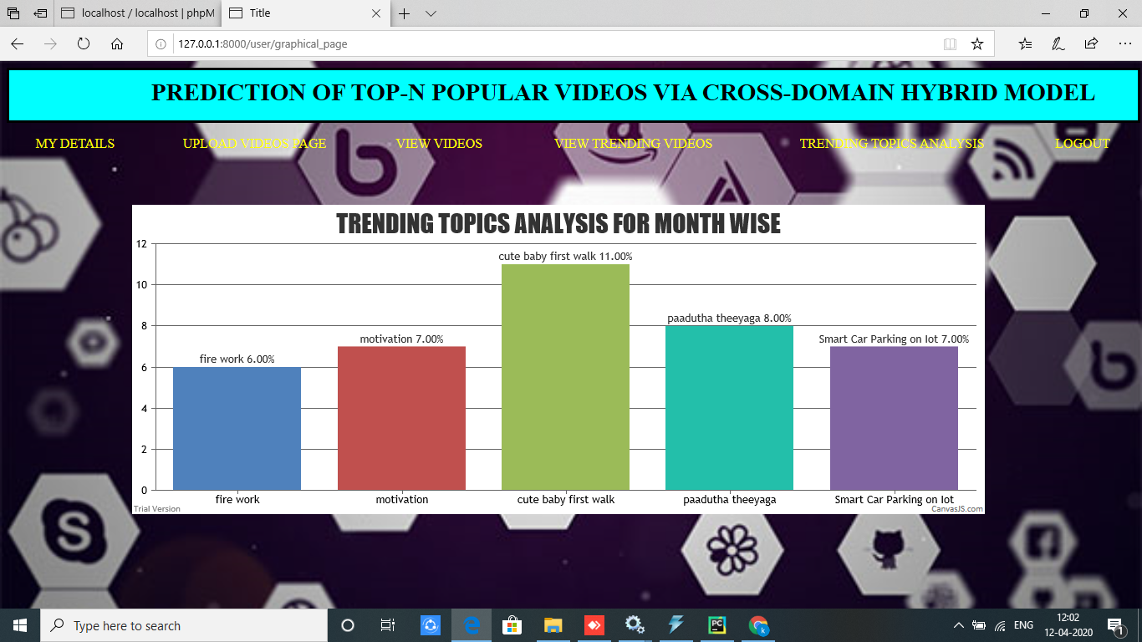
Cont.

Slide 19
Conclusion
We have investigated the problem of top-N popular video prediction and have proposed a novel MFDI prediction model. The proposed model predicts the top -N popular videos by enhancing the ability of early patterns to identify different popularity trends and by optimizing the model’s utilization of multisource data.
Our initial study on popularity prediction for Top-N popular videos

Slide 20
Thank you
Queries
?

